Slide 1
April 2024

Slide 2
SAIMI Background
Role of SAIMI
Operation Phakisa (Oceans Economy)
Oceans Economy and skills Initiatives
Research, Development & Innovation
Enterprise and Supply Development in Oceans Economy
Partnership Agreements
Advocacy and Maritime Awareness
Content

Slide 3
SAIMI Background
2011
Maritime Skills Development Study
Maritime Skills Summit
SAMSA launches National Cadet Programme
2012
Launch of the DTV SA Agulhas
2013
SAIMI feasibility-viability study & business plan
HRD Council forms Maritime Skills Technical Task Team
2014
SAMSA-NMU MoU to collaborate in establishing SAIMI
Presidency launches Operation Phakisa: Oceans Economy
Maritime Skills Technical Task Team delivers recommendations to HRD Council
Launch of SAIMI Nov 2014

Slide 4
SAIMI STRATEGIC THRUSTS
Advocacy and Co-ordination
to promote the maritime sector and increase levels of training and placement of trainees and graduates
Research and Innovation
directly as well as through partner institutions and projects – policy formulation, sector economic growth & opportunities, curriculum development, technology and innovation…
Education, Training, Skills Development
through partner institutions and training service providers

Slide 5
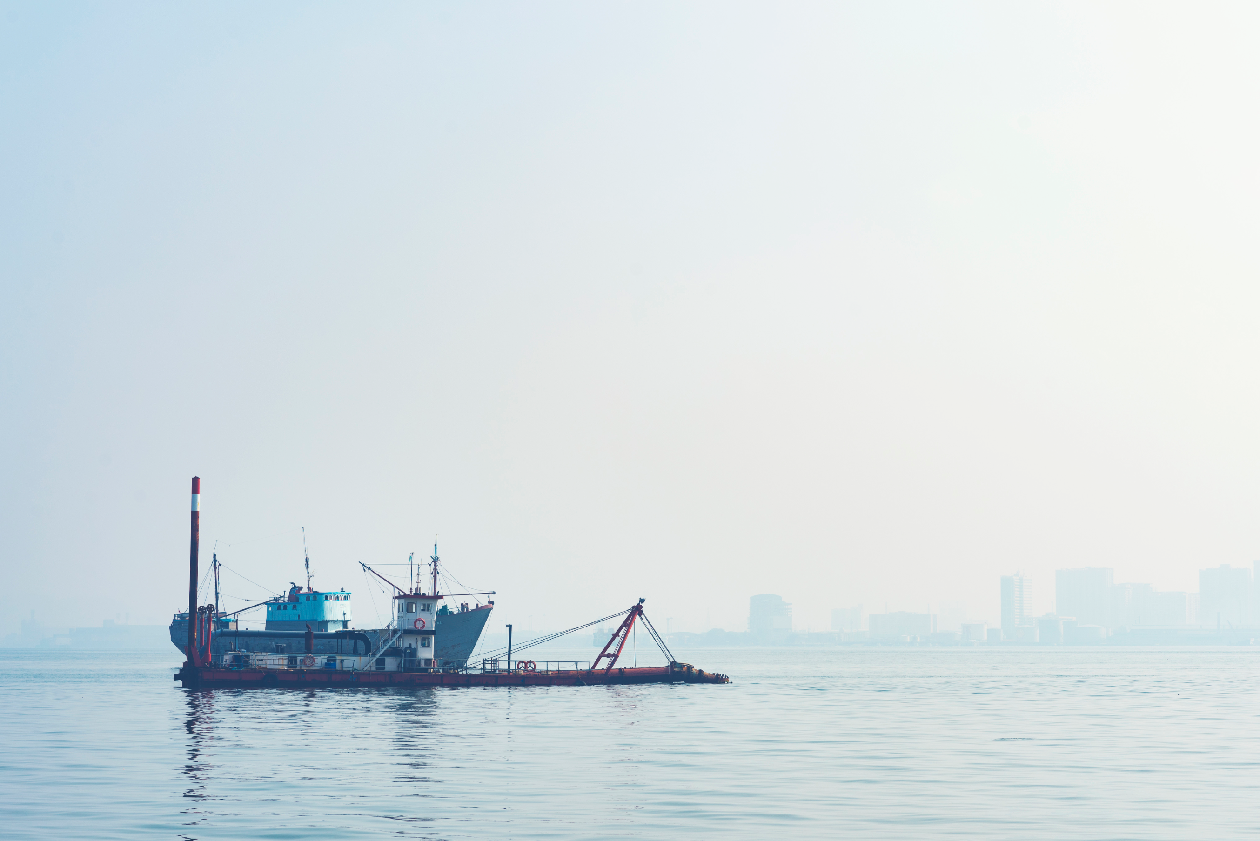
Operation Phakisa (Oceans Economy)
Operation Phakisa (Oceans Economy) in 2014:
Aquaculture
Coastal and Marine Tourism
Marine Transport and Manufacturing
Marine Protection and Ocean Governance
Offshore Oil and Gas Exploration
Small Harbour Development
Fisheries (Ocean Master Plan)
SAIMI mandated by DHET to facilitate the delivery of skills initiatives under Operation Phakisa (Oceans Economy).
OP Skills 3-ft Plans – Multi-stakeholder OP Skills Expert Groups
Academic institutions, TVETs, SETAs, private providers, government and agencies, industry

Slide 6
Oceans Economy Initiatives
Focus Area | Description
Oceans Economy Master Plan | SAIMI has participated and Chaired Task Teams focusing on Skills Development and Research and Transformation: Sector Profiles, SWOT, draft action plans developed OE Masterplan to have subsector plans for each focus area
TVET Capacitation | Promote the participation of the TVET sector in the oceans economy through qualification/ curriculum development, infrastructure and resource development, industry linkages and awareness, staff complement in line with focus areas - advocacy, skills development and capacity building, and research and innovation.
NSF Due Diligence | SAIMI is a partner with NSF in the implementation of the approved projects.
Operation Phakisa Skills Expert Groups | Drive initiatives under the OP Skills 3ft Plans, Change Management. On behalf of the Department

Slide 7
Research, Development & Innovation
Focus Area | Description
Current Studies Publication of Papers from Skills Conference with Juta Offshore Bunkering: Socio-economic study of bunkering in the E.C. | Determine skills needs in the various maritime sub-sectors. Research Papers - Overview of the Skills Required for Marine Protection and Ocean Governance - HSRC’s Labour Market Intelligence Partnership (LMIP) Study and Lessons for the Maritime Sector- A Labour Market Theoretical Analysis. - A proposed education-industry partnership for skills development in the marine manufacturing sector - Applying Systems Thinking Approach to Enterprise Development - The skills and capacity building interventions are required to grow the South African Aquaculture Sector - Skills Development and Capacity Building within the Oceans Economy - South African Maritime Skills Supply & Demand Forward Thinking for Maritime Education and Training Excellence.

Slide 8
Research, Development & Innovation
Focus Area | Description
Completed Studies Coastal Marine Tourism Skills Audit and needs analysis Ocean Protection & Governance Skills Audit and needs analysis Aquaculture Skills Audit and needs analysis Oil and Gas Skills Roadmap Review Small Harbours Skills Audit and Value Chain Analysis Northern Cape Maritime Skills Audit Marine Manufacturing Skills Audit and needs analysis. Seafarer Development Framework Value Chain Study and Development Plan to Increase SMME Participation in the Oceans Economy | Map out a national seafarer development terrain for SAIMI with a clear consideration of the international requirements, starting at the level of basic education all the way through to their absorption into the labour market.

Slide 9
Research, Development & Innovation
Mandela University Maritime Robotics Centre
Activity | Impact
Develop Robotics expertise | 2x Graduates in training appointed to the projects 4x Mechatronics. Eng. final-year projects 2x Masters Student appointed to the projects 2x PhD Student Appointed to the project 1x Mech. Eng. Capstone projects (TBD)
Technical Transfers | This encouraged through the collaborative relationships established and shared projects. Zenith Laser and Aquarius Inflatables have benefited through this interaction
Technical Papers | 1x Technical paper prepared for submission, a second submission expected from the pot-doc appointed to the project
Technology Demonstrators | Two autonomous solar boats to be constructed as demonstrators used for testing equipment and sensors, training staff and equipping the marine robotics unit with assets to encourage industrial support. In addition, a water sampling unit is under development.
Collaborations established | Identified collaboration partners include: University of Cape Town CPUT TUT WSU CSIR Ocean Sciences
International Partners | International partners identified include: Montpellier University Norwegian University of Science and Technology (NTNU) National Oceanographic Centre (UK) University of Southampton (UK) Plymouth University (UK) InOM (Instituto Oceanografico de Moçambique)

Slide 10
Research, Development & Innovation
University of Cape Town Maritime Robotics Centre
Activity | Impact
Develop Robotics expertise | Recruited and actively supervising 12 students. 9 MScEng 3 PhD
Technical Papers | (Scopus papers for Boje, Verrinder, Nichols and Amayo) 6 papers
Technology transfer and technology demonstrators | Establishment delayed
Collaborators | UCT Oceanography.

Slide 11
Enterprise and Supplier Development in Oceans Economy
Oceans Economy Value Chain Study – SAIMI and ECDC | Ten (10) SMME target support per year An enterprise and supplier development strategy for the maritime sector is being finalised by SAIMI to guide its interventions, with the following focus areas: Value chain analysis to outline the different focus areas of the Oceans Economy and opportunities therein Analysis of existing support mechanisms for SMMEs in the Oceans Economy. Develop programmes to facilitate access into the sector. Monitoring and evaluation.
Marine Manufacturing SMME Support Programme. | Partnership between SAIMI and eNtsa to provide support (non-financial) to SMMEs in Marine Manufacturing on the following: Product testing Engineering Research and Development, Consultation Access to technology Human Development (Capacity building)

Slide 12
Partnership Agreements
Focus Area | Purpose/Progress
1. NYDA | Provision of support for youth owned businesses. Undergoing legal processes.
2. Department of Employment and Labour Agreement | Empowerment programmes. Job Opportunities. Undergoing legal processes.
3. Department of Basic Education Agreement | Strategic support for Maritime High Schools. Qualification Development (Maritime Teaching) at UKZN Policy/Gidelines on Maritime Focused Schools
4. Industry Council | Strengthen relations; Supply and Demand; Work Placement Opportunities. Inaugural meeting held.
5. International Association of Maritime Universities (IAMU) | Lecturer and Student Exchange; Bursaries; Research Collaboration. IAMU Board approved collaboration proposal with SAIMI. An IAMU Task Team to be set up to unpack the proposed collaboration further. Undergoing legal processes with inputs from the Research Directorate.
6. Walter Sisulu University (WSU) | Provide support for skills development and capacity building for the Operation Phakisa Water Quality Monitoring project driven by the University
7. Global Maritime Forum | Participated in the development of the Global Report on opportunities derived from decarbornisation.
8. Oil and Gas CoP, Aquaculture CoP and Naval Architecture Research Chair | Partnership with the NRF, by collaborating and co-investing in the establishment of the CoP’s and Research Chair under the SARChI Programme.

Slide 13
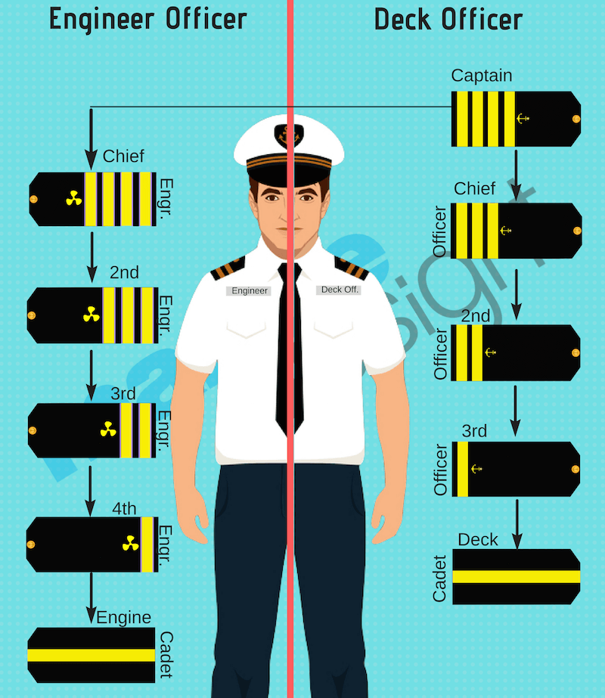
SAIMI facilitates and manages the NSDP which focuses on the training of:
Officers in Charge of the Navigational Watch (Deck Officers/Cadets)
Officers in Charge of the Engineering Watch (Marine Engineers/Cadets)
Officers in Charge of an Electrical Watch (Electro-Technical Officers/Cadets)

Slide 14
The total number of active cadets as of 30 June 2023, as follows:
Category | No. of Cadets
Deck | 109
Engine | 54
MEK | 0
Electro-Technical | 09
Tanker Conversion | 11
Total | 183
Notes:
A Multi stakeholder Steering Committee is responsible for the corporate governance and strategic direction of SAIMI.

Slide 15
Dive In Website & APP is zero rated and available to download on iOS and Play store.
The website and APP is for all learners and students with an interest in the Maritime Sector.
Dive In
Website &
APP

Slide 16
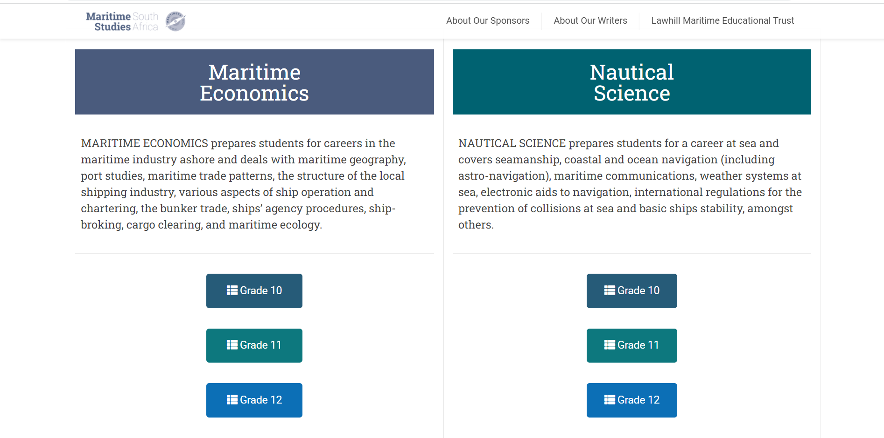
Advocacy and Awareness
SAIMI/Lawhill Nautical Science Online Text Book Project

Slide 17
Thank you.
Notes:
Thank you for allowing me five minutes to introduce you to SAIMI and some of our work in South Africa and I warmly welcome our panellists to continue discussions.

